Slide 1

Very low exposure simulator
Team Members:
Pralhad Yadawad
Nitish Kumar Pathak
Aryan Kamat
Aditya Phatak
Lokesh Pandey
Robin Jenkin | Ujwala Patil | April 2024

Slide 2
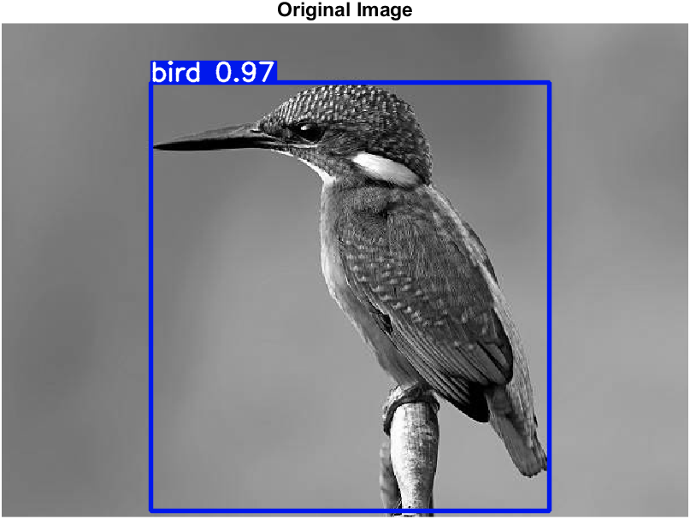
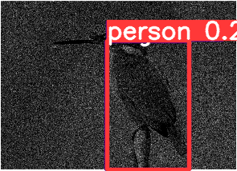
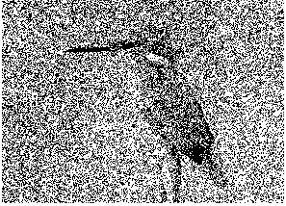
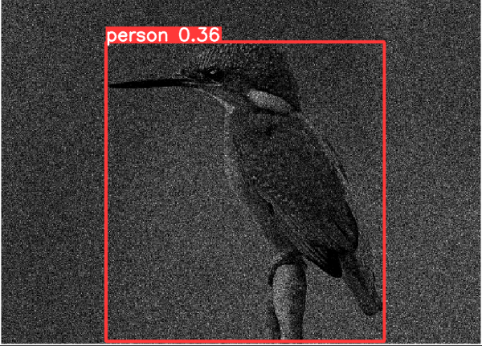
Implementation of YOLOv9 on single channel images
No output was displayed for other low exposure images
1.5 million quanta
0.5 million quanta
2 million quanta

Slide 3
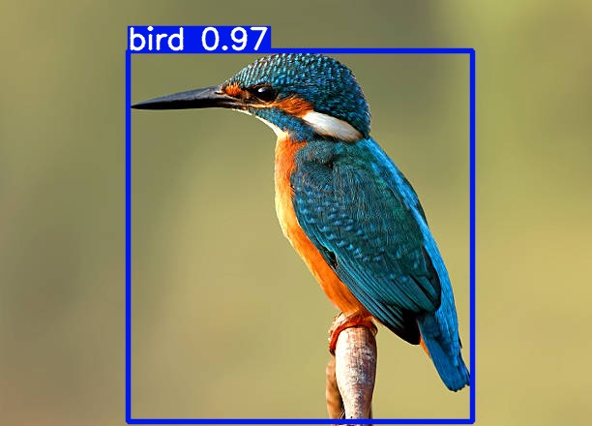
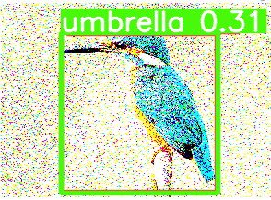
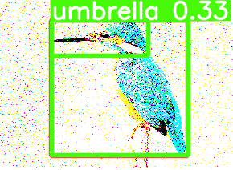
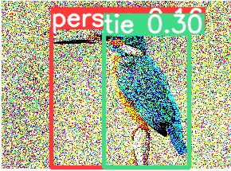
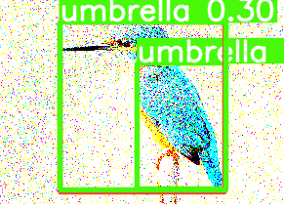
Implementation of YOLOv9 on three channel images
4 million quanta
6 million quanta
No output was displayed for other low exposure images
2 million quanta
5 million quanta

Slide 4
Thank You

